Slide 1
INHERITANCE

Slide 2
INHERITANCE BASICS
Inheritance in java is a mechanism in which one class acquires all the properties and behaviors of parent class.
The idea behind inheritance in java is that you can create new classes that are built upon existing classes. When you inherit from an existing class, you can reuse methods and fields of parent class, and you can add new methods and fields also.
Inheritance represents the IS-A relationship, also known as parent-child relationship.

Slide 3
INHERITANCE BASICS
Terms used in Inheritance
o Class: A class is a group of objects which have common properties. It is a
template or blueprint from which objects are created.
o Sub Class/Child Class: Subclass is a class which inherits the other class. It
is also called a derived class, extended class, or child class.
o Super Class/Parent Class: Superclass is the class from where a subclass
inherits the features. It is also called a base class or a parent class.
o Reusability: As the name specifies, reusability is a mechanism which
facilitates you to reuse the fields and methods of the existing class when you create a new class. You can use the same fields and methods already defined in the previous class.

Slide 4
INHERITANCE BASICS
Code Reusability: Inheritance allows for code reuse and reduces the amount of code that needs to be written. The subclass can reuse the properties and methods of the superclass, reducing duplication of code.
Abstraction: Inheritance allows for the creation of abstract classes that define a common interface for a group of related classes. This promotes abstraction and encapsulation, making the code easier to maintain and extend.
Class Hierarchy: Inheritance allows for the creation of a class hierarchy, which can be used to model real-world objects and their relationships.
Polymorphism: Inheritance allows for polymorphism, which is the ability of an object to take on multiple forms. Subclasses can override the methods of the superclass, which allows them to change their behavior in different ways.

Slide 5
INHERITANCE BASICS
Syntax of Java Inheritance
class Subclass-name extends Superclass-name
{
//methods and fields
}
•The extends keyword indicates that you are making a new class that derives from an existing class. The meaning of "extends" is to increase the functionality.
•In the terminology of Java, a class which is inherited is called parent or super class and the new class is called child or subclass.

Slide 6
INHERITANCE BASICS
Types of inheritance in java
•On the basis of class, there can be three types of inheritance in java:
Single Inheritance
Multilevel Inheritance
Hierarchical Inheritance
•In java programming, Java does not support Multiple & Hybrid Inheritance with classes directly. Multiple and hybrid inheritance is supported through interface only . We will learn about interfaces later.

Slide 7
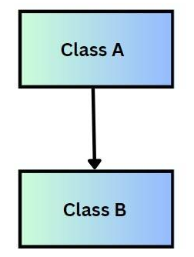
SINGLE INHERITANCE
Single Inheritance in java
In single inheritance, a sub-class is derived from only one super class. It inherits the properties and behavior of a single-parent class. Sometimes, it is also known as simple inheritance.
Single Inheritance = One child, one parent.
Implemented using extends keyword.
Helps in achieving code reusability and hierarchical structure in Java OPP.

Slide 8
SINGLE INHERITANCE
Single Inheritance Syntax
class Parent {
// fields and methods of parent class
}
class Child extends Parent {
//fields and methods of child
}

Slide 9
SINGLE INHERITANCE Example
_{class A{}
_{int i, j;}
_{void show() {}
System.out.println("i ="+i +" "+"j ="+j);}}
_{class B extends A{}
_{int k,l;}
_{void sum() {}
System.out.println("i ="+i +" "+"j = "+j +" k ="+k);
_{int sum=i+j+k;}
System.out.println("Sum ="+sum);}}
_{public class type1 {}
public static void main(String[] args) {
_{A obj1 = new A();}
_{obj1.i=85;}
_{obj1.j=12;}
_{obj1.show();}
_{B obj2 = new B();}
_{obj2.k=62;}
_{obj2.i=22;}
_{obj2.j=90;}
_{obj2.sum();}}}
OUTPUT :
i =85 j =12
i =22 j = 90 k =62
Sum =174

Slide 10
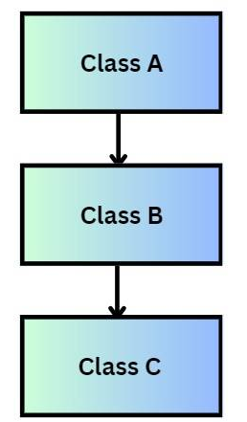
MULTILEVEL INHERITANCE
Multilevel Inheritance in java
In Multilevel Inheritance, a derived class will be inheriting a base class and as well as the derived class also acts as the base class for other classes.
Multilevel Inheritance is a feature that allows a class to inherit properties and behavior from another class, which in turn inherits from another class, forming a "chain" of inheritance.
Real life example : Grandfather Father Child
The child inherits traits from both the father and grandfather.
Follows “is-a relationship”, C is B, is A.

Slide 11
MULTILEVEL INHERITANCE
Multilevel Inheritance Syntax
class Grandparent {
// fields and methods of Grandparent class
}
class Parent extends Grandparent {
//fields and methods of Parent Class
}
class Child extends Parent {
//fields and methods of Child Class
}

Slide 12
MULTILEVEL INHERITANCE
class A{
int i, j;
void show() {
System.out.println("i ="+i +" "+"j ="+j);}}
class B extends A{
int k,l;
void sum() {
System.out.println("i ="+i +" "+"j = "+j +" k ="+k);
int sum=i+j+k;
System.out.println("Sum ="+sum);}}
class C extends B{
void product() {
int product =i*j*k;
System.out.println("Product ="+product);}}
public class type2 {
public static void main(String[] args) {
A obj1 = new A();
obj1.i=85;
obj1.j=12;
obj1.show();
B obj2 = new B();
obj2.k=62;
obj2.i=22;
obj2.j=90;
obj2.sum();
C obj3 =new C();
obj3.i=11;
obj3.j=22;
obj3.k=33;
obj3.product();}}
OUTPUT –
i =85 j =12
i =22 j = 90 k =62
Sum =174
Product =7986

Slide 13
HIERARCHICAL INHERITANCE
Hierarchical Inheritance in java
In hierarchical inheritance, more than one subclass is inherited from a single base class. i.e. more than one derived class is created from a single base class.
Hierarchical inheritance in Java is a type of inheritance where multiple subclasses inherit from a single parent (superclass). In other words, one parent class acts as the base, and multiple child classes extend it.
Hierarchical inheritance in Java is a type of inheritance where multiple subclasses inherit from a single superclass. This creates a tree-like structure where the superclass is at the top, and multiple child classes branch out from it.

Slide 14
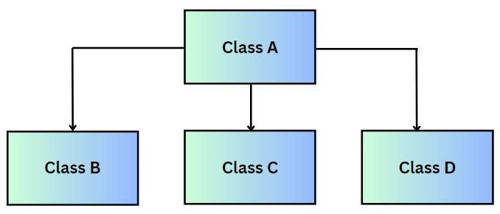
HIERARCHICAL INHERITANCE
One superclass, multiple subclasses.
Each subclass inherits the properties and methods of the parent class, but can also define its own behavior.
Useful when several classes share common functionality (from the parent) but also need unique behaviors.

Slide 15
HIERARCHICAL INHERITANCE
class P{
int i, j;
void show() {
System.out.println("i ="+i +" "+"j ="+j);}}
class Q extends P{
void sum() {
int sum=i+j;
System.out.println("Sum ="+sum);}}
class R extends P{
void product() {
int product =i*j;
System.out.println("Product ="+product);}}
public class type3 {
public static void main(String[] args) {
P obj1 = new P();
obj1.i=10;
obj1.j=10;
obj1.show();
Q obj2 = new Q();
obj2.i=20;
obj2.j=20;
obj2.sum();
obj2.sum();
R obj3 =new R();
obj3.i=30;
obj3.j=30;
obj3.product();}
}
OUTPUT –
i =10 j =10
Sum =40
Product =900

Slide 16
WHY NOT MULTILEVEL INHERITANCE IN JAVA ?
Why Multiple Inheritance is Not Allowed in Java
In Java, a class cannot directly inherit from more than one class. This restriction was made by the language designers to keep the language simple, secure, and free from ambiguity. The main reasons are:
Ambiguity (Diamond Problem): If two parent classes have a method with the same name, the child class will not know which one to inherit. This leads to confusion during method calls.
Variable Conflicts: If two parent classes contain fields (variables) with the same name, it becomes unclear which one should be used by the child class.

Slide 17
WHY NOT MULTILEVEL INHERITANCE IN JAVA ?
Constructor Confusion: While creating an object, Java calls the parent class constructor first. With two or more parents, the order of constructor calls would become uncertain.
Simplicity and Maintainability: Allowing multiple inheritance would make Java complex like C++, making code harder to read, maintain, and debug. By avoiding it, Java keeps the object model simple and predictable.

Slide 18
MEMBER ACCESS & INHERITANCE
In Java, private members of a class include its fields (variables), methods, and constructors declared with the private modifier.
Not Inherited by Subclasses - Private members of a parent class are not accessible directly in the child class. Even though child inherits structure of parent, private members remain hidden and cannot be used directly.
Accessible Only Within the Same Class - Private members can only be accessed inside the class where they are declared. Neither subclasses in the same package nor subclasses in different packages can access them.
Indirect Access Through Methods - A common practice is to use public or protected getter/setter methods in the parent class .
Encapsulation - This preserves encapsulation by keeping the actual variable private but exposing limited, safe access.

Slide 19
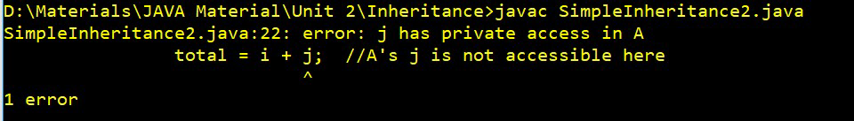
MEMBER ACCESS & INHERITANCE
class A
{int i;
private int j;
void setij(int x, int y)
{i = x;
j = y;} }
class B extends A
{int total;
void sum()
{total = i + j;
class SimpleInheritance2
{public static void main(String args[])
{B subOb = new B();
subOb.setij(10, 12);
subOb.sum();
System.out.println("Total is " + subOb.total);
}}

Slide 20
A SUPERCLASS VARIABLE CAN REFERENCE SUBCLASS OBJECT
When Inheritance exists, it is possible for a reference variable of the superclass to refer to (or point to) an object of the subclass.
A reference variable of a super class can be assigned a reference to any subclass derived from that super class.
This concept is the foundation of Polymorphism in Java.
Polymorphism means “many forms” , it allows one action (method call) to behave differently depending on the object that performs it.
When a superclass reference variable can refer to objects of its subclasses, and the method called depends on the object type, not the reference type – that’s runtime polymorphism.
This makes Java more flexible, reusable and extensible.

Slide 21
USING SUPERCLASS VARIABLE CAN REFERENCE SUBCLASS OBJECT
SUPER
class AA{
int i, j;
void show() {
System.out.println("i ="+i +" "+"j ="+j);}}
class BB extends AA{
int k,l;
void sum() {
System.out.println("i ="+i +" "+"j = "+j +" k ="+k);
int sum=i+j+k;
System.out.println("Sum ="+sum);}}
public class superclassreference {
public static void main(String[] args) {
AA obj1 = new AA();
obj1.i=85;
obj1.j=12;
BB obj2 = new BB();
obj2.k=62;
obj2.i=22;
obj2.j=90;
obj1 = obj2;
obj1.show();}}
OUTPUT :
i =22 j =90

Slide 22
USING SUPER
Whenever derived class inherits base class features, there is a possibility that base class features are similar to derived class features and JVM gets an ambiguity. To overcome this, super is used to refer super class properties.
The super keyword in Java is a reference variable that is used to refer to the parent class when we are working with objects.
Usage of Java super Keyword :-
Use of super with variables
Use of super with methods
Use of super with constructors

Slide 23
USING SUPER
Characteristics of Super Keyword in Java :-
Calling the Parent Class Constructor: When we create an object of the subclass, its constructor needs to call the constructor of the parent class.
Accessing Parent Class Methods: If subclass wants to access methods of parent class, it can also be done with the help of the super keyword.
Accessing Parent Class Variables: Fields from the parent class can also be accessed using the super keyword in the subclass.
First Statement in a Constructor: When calling a superclass constructor, the super() statement must be the first statement in the constructor of the subclass. This ensures that the parent class is properly initialized before the subclass does anything else.
Cannot be used in Static Context: We cannot use super in a static variable, static method and static block.

Slide 24
USING SUPER TO ACCESS MEMBERS OF SUPERCLASS
Super can used to access members can be instance variables or methods of superclass.
When a subclass declares variables with the same name as superclass variables then subclass variables hides (or shadows) the superclass one.
To access hidden superclass members – instance variables or methods, we can use super.
To distinguish between between subclass and superclass same variables we can use super.
Syntax – super.member;

Slide 25
USING SUPER TO ACCESS MEMBERS OF SUPERCLASS
class Asuper{
int i =100;
int j =100;
void show() {
System.out.println("i ="+i +" "+"j ="+j);}}
class Bsuper extends Asuper{
int k;
int i =6000;
int j =5000;
void sum1() {
System.out.println("i ="+ i +" "+"j = "+ j +" k ="+k);
int sum=i+j+k;
System.out.println("Sum ="+sum);}
void sum2() {
System.out.println("i ="+super.i +" "+"j = "+super.j +" k ="+k);
int sum=super.i+super.j+k;
System.out.println("Sum ="+sum);}}
public class super1 {
public static void main(String[] args) {
Bsuper obj2 = new Bsuper();
obj2.k=401;
obj2.sum1();
obj2.sum2();}}
OUTPUT :-
Without using Super :
i =6000 j = 5000 k =401
Sum =11401
With Super :
i =100 j = 100 k =401
Sum =601

Slide 26
USING SUPER TO ACCESS MEMBERS OF SUPERCLASS
OUTPUT :-
Without using Super :
i =6000 j = 5000 k =401
Sum =11401
With Super :
i =100 j = 100 k =401
Sum =601
In sum1 method – All instance variables i, j and k values are initialized in subclass SuperB itself.
In sum2 method – Instance variables i and j are accessed from the superclass SuperA using super and k is initialized in SuperB only.

Slide 27
USING SUPER TO CALL SUPERCLASS
CONSTRUCTOR
The Super keyword is used within a subclass constructor to explicitly call a constructor of its immediate superclass.
This mechanism is crucial for ensuring proper initialization of inherited fields and for reusing initialization logic defined in the parent class.
Syntax – super( ) – this calls the default constructor of the superclass
super(parameter-list) – this calls a parametrized constructor
of the superclass, passing the specified parameter list to it.
The call to super ( ) or super(parameter list) must be the first statement within the subclass constructor.

Slide 28
USING SUPER TO CALL SUPERCLASS Default CONSTRUCTOR
class Box{
double width;
double height;
double depth;
Box(){
System.out.println("Default Constructor of Superclass Called"); }
Box(double w, double h, double d) {
width = w;
height = h;
depth = d; }
double volume() {
return width * height * depth;}}
class Boxweight extends Box {
double weight;
Boxweight(double m) {
super();
weight = m; }}
public class super2{
public static void main (String args[]) {
Boxweight mybox1 = new Boxweight(10);
double vol = mybox1.volume();
System.out.println("Volume of mybox1 is " + vol);
System.out.println("Weight of mybox1 is " + mybox1.weight);
System.out.println();}}
OUTPUT –
Default Constructor of Superclass Called
Volume of mybox1 is 0.0
Weight of mybox1 is 10.0

Slide 29
USING SUPER TO CALL SUPERCLASS Parametrized CONSTRUCTOR
class Box{
double width;
double height;
double depth;
Box(){
System.out.println("Default Constructor of Superclass Called");}
Box(double w, double h, double d) {
width = w;
height = h;
depth = d;}
double volume() {
return width * height * depth;}}
class Boxweight extends Box {
double weight;
Boxweight(double w, double h, double d, double m) {
super(w, h, d);
weight = m;}}
public class super2{
public static void main (String args[]) {
Boxweight mybox1 = new Boxweight(10, 20, 15, 34.3);
double vol = mybox1.volume();
System.out.println("Volume of mybox1 is " + vol);
System.out.println("Weight of mybox1 is " + mybox1.weight);
System.out.println();}}
OUTPUT –
Volume of mybox1 is 3000.0
Weight of mybox1 is 34.3

Slide 30
METHOD OVERIDDING
Method Overriding takes place when a subclass (child class) provides its own implementation or we can say have defined method as in superclass (parent class).
By same method , it means a method having same signature in both superclass and subclass.
Method Signature is defined by –
Method Name
Parameter List (number of parameters, datatype of parameter and order of parameters)
Return Type and Access Modifiers are not parts of method signature, but return type should also be same.
All 3 (number, datatype and order) has to be same for same method signature.

Slide 31
METHOD OVERIDDING
class BoX{
double width;
double height;
double depth;
BoX(int a, int b) {
width = a;
height = b;}
double vol() {
return width*height;}}
class BoxWeight extends BoX{
BoxWeight(int a, int b, int c) {
super(a, b);
depth=c;}
double vol() {
return width*height*depth;}}
public class methodoveriding {
public static void main(String[] args) {
BoX obj11 = new BoX(10,20);
double volvalue11 = obj11.vol();
System.out.println("Volume for obj11 = "+volvalue11);
BoxWeight obj22 = new BoxWeight(34, 67, 89);
double volvalue22 = obj22.vol();
System.out.println("Volume for obj22 = "+volvalue22);}}
OUTPUT :-
Volume for obj11 = 200.0
Volume for obj22 = 202742.0

Slide 32
METHOD OVERIDDING
METHOD OVERLOADING | METHOD OVERRIDING
Within the same class | Between a superclass and a subclass
Same name, but different parameter list | Same method signature
Compile – Time Polymorphism | Runtime Polymorphism
No Inheritance required | Inheritance required
Increase readability, provides varied functionality | Provides specific implementation for inheritance methods

Slide 33
When Constructors are Executed
When a class Hierarchy is created, in what order are constructors for the classes that makeup the hierarchy executed ???
For example given a subclass B and a superclass called A, is A’s constructor executed before B’s, or vice versa ???
In a class hierarchy, constructors complete their execution in order of derivation, from superclass to subclass.
Constructors complete their execution in order of derivation.

Slide 34
When Constructors are Executed
class Red {
Red() {
System.out.println("Inside A's constructor.");}}
class Blue extends Red {
Blue() {
System.out.println("Inside B's constructor.");}}
class Green extends Blue {
Green() {
System.out.println("Inside C's constructor.");}}
public class consructorcallorder {
public static void main(String[] args) {
Green c = new Green();}}
OUTPUT –
Inside A's constructor.
Inside B's constructor.
Inside C's constructor.

Slide 35
DYNAMIC METHOD DISPATCH
Method overriding forms the basis for one of Java’s most powerful concepts: dynamic method dispatch.
Dynamic method dispatch is important because this is how Java implements run-time polymorphism.
We know, a superclass reference variable can refer to a subclass object. Java uses this fact to resolve calls to overridden methods at run time.
It is a runtime polymorphism.

Slide 36
DYNAMIC METHOD DISPATCH
When an overridden method is called through a superclass reference, Java determines which version of that method to execute based upon the type of the object being referred to at the time call occurs. Thus, this determination is made at run time.
It is the type of the object being referred to (not the type of the reference variable) that determines which version of an overridden method will be executed.
Therefore, if a superclass contains a method that is overridden by a subclass, then when different types of objects are referred to through a superclass reference variable, different versions of the method are executed i.e. when reference variable r will point to a object it will call a class method, when r will be made to point to b now, it will call b class method.

Slide 37
DYNAMIC METHOD DISPATCH
class Aone {
void callme() {
System.out.println("Inside A's callme method");}}
class Btwo extends Aone {
void callme() {
System.out.println("Inside B's callme method");}}
class Cthree extends Aone {
void callme() {
System.out.println("Inside C's callme method");}}
public class dynamicmethod {
public static void main(String args[]) {
Aone a = new Aone();
Btwo b = new Btwo();
Cthree c = new Cthree();
Aone r;
r = a;
r.callme();
r = b;
r.callme();
r = c;
r.callme(); }}
OUTPUT –
Inside A's callme method
Inside B's callme method
Inside C's callme method

Slide 38
DYNAMIC METHOD DISPATCH
In method overriding, we declare a object of a particular class to call method of that class and overcomes the method overriding. For a method to be overridden, it must have same name, return type and method signature. An overridden method is called using reference variable to which it belongs.
In dynamic method dispatch, we create new reference variable of superclass, which will point to the subclass object, in turn calls subclass overridden method. When a superclass reference variable refers to a subclass object, and an overridden method is called using this reference, the JVM determines which version of the method to execute based on object’s actual type.
Both supports runtime polymorphism.

Slide 39
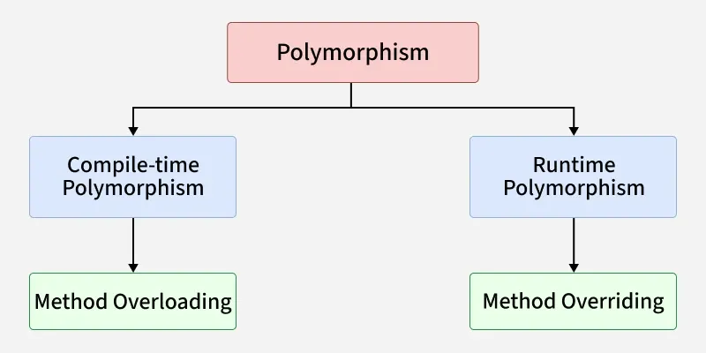
POLYMORPHISM
Polymorphism of OOPs in Java, allows objects to take on many forms. The word "polymorphism" means "many forms." It enables a single action to be performed in different ways, based on the object performing the action.

Slide 40
POLYMORPHISM
Compile-time Polymorphism (Static Polymorphism/Method Overloading): This occurs when multiple methods within same class share same name but have different parameter lists. The Java compiler determines which overloaded method to call based on arguments passed during method invocation at compile time.
Runtime Polymorphism (Dynamic Polymorphism/Method Overriding): This occurs when a subclass provides a specific implementation for a method that is already defined in its superclass. The method to be executed is determined at runtime, based on the actual type of the object being referred to by the reference variable. This relies on inheritance and upcasting, where a superclass reference variable refers to an object of a subclass.

Slide 41
ABSTRACT CLASS
• A class which is declared with the abstract keyword is known as an abstract class in Java. It can have abstract and non-abstract methods (method with the body).
• Abstraction is a process of hiding the implementation details and showing only functionality to the user.
• Another way, it shows only essential things to the user and hides the internal details, for example, sending SMS where you type the text and send the message. You don't know the internal processing about the message delivery.
• Abstraction lets you focus on what the object does instead of how it does it.
• There are two ways to achieve abstraction in java –
-- Abstract class
-- Interface

Slide 42
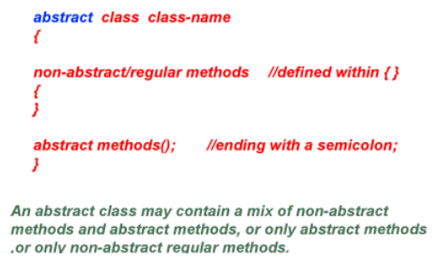
ABSTRACT CLASS

Slide 43
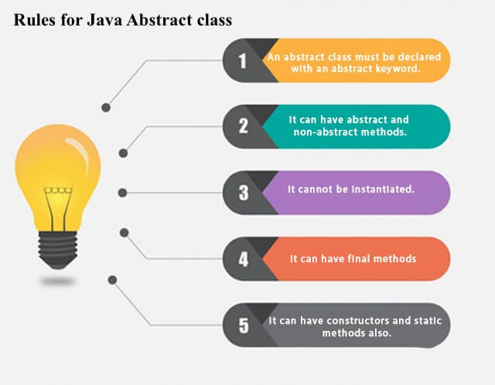
ABSTRACT CLASS

Slide 44
ABSTRACT CLASS
abstract class Shape {
String color;
Shape(String color) {
this.color = color;}
abstract double area();
void getColor() {
System.out.println("Color: " + color);}}
class Circle extends Shape {
int radius;
Circle(String color, int radius) {
super(color);
this.radius = radius;}
double area() {
return 3.14 * radius * radius;}}
public class GFG{
public static void main(String[] args) {
Shape s = new Circle("Red", 5);
s.getColor();
System.out.println("Area: " + s.area());
}}
OUTPUT :
Color: Red
Area: 78.5

Slide 45
ABSTRACT CLASS
In Java, just like in C++ an instance of an abstract class cannot be created, we can have references to abstract class type though. It is as shown below via the clean Java program.
Like C++, an abstract class can contain constructors in Java. And a constructor of an abstract class is called when an instance of an inherited class is created.
In Java, we can have an abstract class without any abstract method. This allows us to create classes that cannot be instantiated but can only be inherited.
Abstract classes can also have final methods (methods that cannot be overridden)
For any abstract java class we are not allowed to create an object i.e., for an abstract class instantiation is not possible.

Slide 46
Final in Inheritance
1. Using final to Prevent Overriding –
While method overriding is one of Java’s most powerful features, there will be times when you will want to prevent it from occurring. To disallow a method from being overridden, specify final as a modifier at the start of its declaration. Methods declared as final cannot be overridden. The following fragment illustrates final:
class A {
final void meth() {
System.out.println("This is a final method.");}}
class B extends A {
void meth() { // ERROR! Can't override.
System.out.println("Illegal!");}}

Slide 47
Final in Inheritance
2. Using final to Prevent Inheritance -
Sometimes you will want to prevent a class from being inherited. To do this, precede the class declaration with final. Declaring a class as final implicitly declares all of its methods as final, too. As you might expect, it is illegal to declare a class as both abstract and final since
an abstract class is incomplete by itself and relies upon its subclasses to provide complete implementations.
Here is an example of a final class:
final class A {
//...}
// The following class is illegal.
class B extends A { // ERROR! Can't subclass A
//...}

